Slide 1
Lecture #14: Data Modelling
CME2002 Data Organization and Management
Dr.Adil Alpkocak

Slide 2
What is Data Modeling?
Data Modeling: an organized view of the data of an enterprise for the purpose of implementation in a database management system
Model Types
Relational
Hierarchical
Network
Relational Modeling Formats
Entity Relationship Diagram (ERD)
IDEF1x
Information Engineering (IE)

Slide 3
Database: Collection of Tables

Slide 4
Purchase Order Form

Slide 5
Elements of a Data Model: Entities and Relationships
Entity- a person, place, event, thing, or concept about which information is to be kept in the database.
Strong Entity: is not existence dependent on some other entity
Weak Entity: depends on another entity for its existence
Relationship – an association between entities
Mandatory participation: each instance of the entity must be a participant in the relationship
Optional participation: some instances of the entity may not participate in the relationship

Slide 6
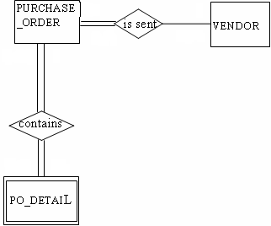


Example of an ERD Model: Entities & Relationships
V_NAME
PHONE
ITEM_ AMOUNT
UNIT_COST
QTY
Strong Entity
Mandatory (Full) Participation
Weak Entity
Optional (Partial) Participation

Slide 8
Elements of a Data Model: Cardinality
Cardinality: expresses the number of entity occurrences associated with the occurrence of a related entity
(1:M), (1:1), (M:N)
Cardinality Limits: expresses the domain (range) of the cardinality
Shows the domain of the relationship on the opposite side of the relationship arc
(1,10) – range of a (1:M) relationship is in the domain 1 to 10

Slide 9
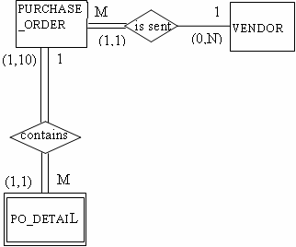
Example of an ERD Model: Cardinality
Cardinality
One-to-many 1:M
One-to-one 1:1
Many-to-many M:N
Cardinality Limits
One and only one (1,1)
One to ten (1,10)
Zero to many (0,M)

Slide 10
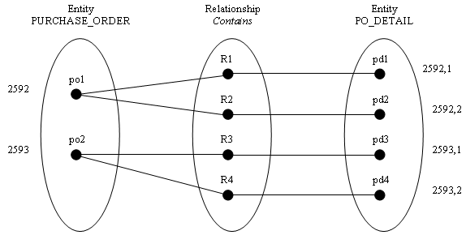
Semantic Net Diagrams: Example of 1:M Relationship
Notes
Each relationship has exactly 1 node in the relationship oval
For at least 1 purchase order node there exists more than one po_detail node. This is a 1:M relationship

Slide 11
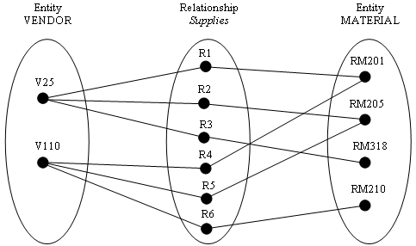
Semantic Net Diagrams: Example of M:N Relationship
Notes
For at least 1 vendor node there exists more than one material node and, for at least one material node there exists more than one vendor node. This is an M:N relationship
If, for at least 1 vendor node there is no relationship node. Vendor is optional to the relationship and the cardinality limits are (0,M)

Slide 12
Business Rules
What are Business Rules?
Business Rules describe how the enterprise operates and the business rules should be reflected in the data model
Example: If an enterprise limits the number of line items on a purchase order to 20, then the cardinality limits on the M side of the relationship is (1,20)
Example: If a company does not qualify a vendor until it writes a purchase order to that vendor, then Vendor is mandatory to the relationship and the cardinality limits are (1,M). A Vendor must have a Purchase Order
Example: If a company qualifies a vendor without writing a purchase order to that vendor, then Vendor is optional to the relationship and the cardinality limits are (0,M). A Vendor may have a Purchase Order

Slide 13
Elements of a Data Model: Attributes Example
RELEASE_
DATE
PO_AMT
PO_NUMBER
PO_STATUS
PURCHASE_ORDER
M
1
VENDOR
(1,1)
is sent
(0,N)
V_TEL_
NO
(1,10)
1
VENDOR_ID
VENDOR_
ADDRESS
Contains
V_NAME
(1,1)
M
PO_DETAIL
PROMISED_
DEL_DATE
UNIT_COST
PO_ LINE_ITEM
MATERIAL_ID
QUANTITY
UNIT
BALANCE
STATUS

Slide 14
Composite Entities

Slide 15
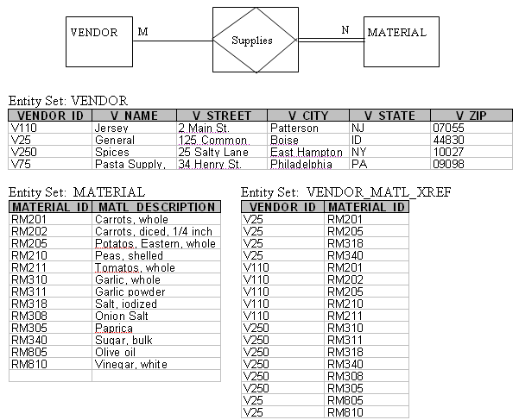
Composite Entities
Composite Entity: An entity that is created when a M:N relationship exists in the data model.
A composite entity is shown as a relationship diamond with a box around it.
It indicates that the M:N relationship should be broken down into two 1:M relationships when implemented in a database.

Slide 16
Degree of a Relationship
The degree of a relationship is a measure of the number of entities that share the same association.
Binary: when two, and only two, entities share the same association. This is the most common.
Ternary: when three entities share a common relationship.
Unary: when an entity shares a relationship with itself.
N-ary: when more than three entities share a common relationship. This is not often encountered.

Slide 17

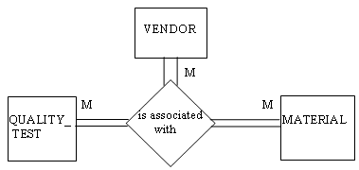
Degree of a Relationship: Examples
Binary
Ternary
Note: It is desirable to break a ternary relationship down into a set of binary relationships before implementing into a set of database tables.

Slide 18
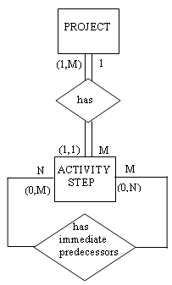
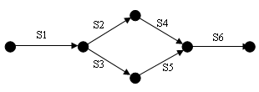
Degree of a Relationship: Examples
Unary

Slide 19
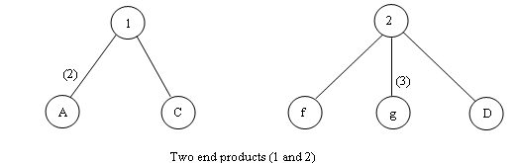
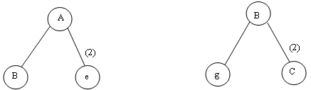
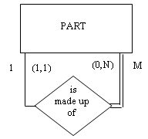
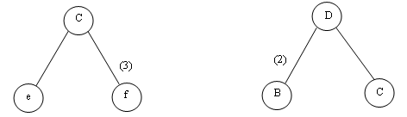
Recursive Entities
Entities with unary relationships are also called recursive entities.
Important entities in industrial applications are recursive.
Bill of Materials(BOM): Two end products (1 & 2) and four subassemblies (A,B,C,D)

Slide 20
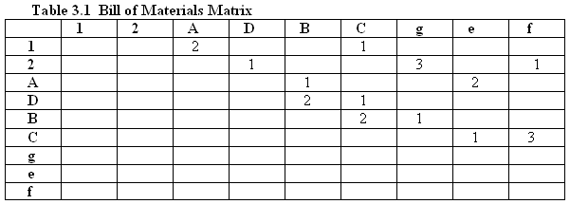
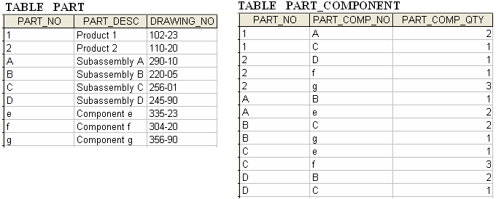
Recursive Entities
Bill of Materials Matrix

Slide 21
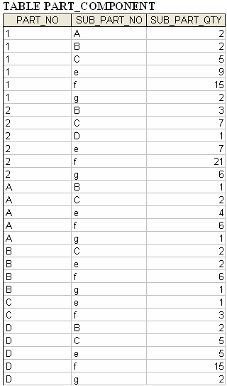
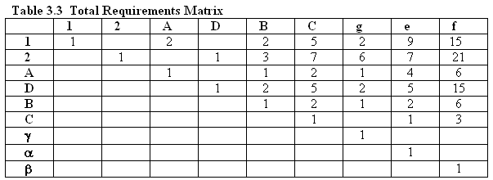
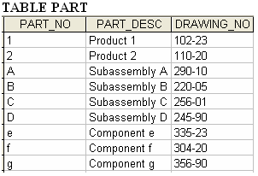
Recursive Entities
Total Requirements Matrix
Eliminates the need for coding an algorithm to make recursive calls on table structure based on simple requirements matrix.

Slide 22
Superclass & Subclass Entity Types
Superclass: an entity type that represents a set of similar people, places, or things that have some common attributes but represent distinct subclasses.
Subclass: an entity type that is a member of a superclass but has distinct attributes that are not common with all other members of the superclass.

Slide 23
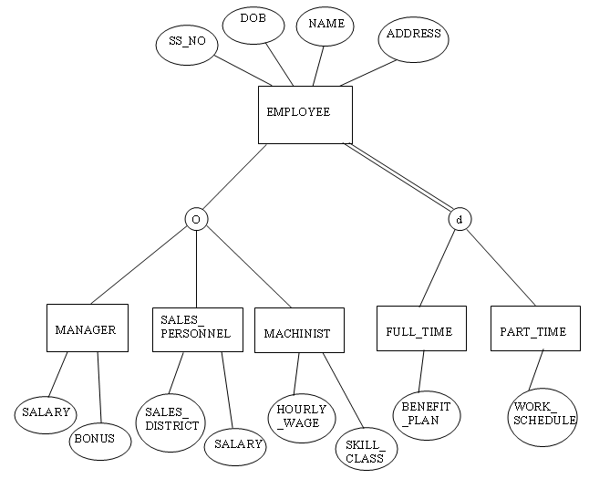
Superclass & Subclass Entity Types: Examples
o: overlapping
d: distinct

Slide 24
Case Study in E-R Diagramming
In actual cases, the analyst must uncover the entities, attributes, and relationships of the enterprise.
It is important to uncover “business rules” that govern the way the enterprise functions and to embed these rules in the data model.
In this case study we assume the business rule has been defined and illustrate its implementation in the data model.

Slide 25
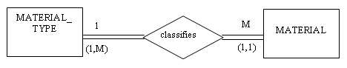
Case Study in E-R Diagramming: Example
Managing inventoried materials in the enterprise
Business Rule #1: The department is responsible for the inventory of three material types: raw material, finished goods, and supplies. Each material, identified by a material ID, belongs to one material type. Each material type classifies many different materials.
Note: Material_Type and Material are “concepts”, not tangible things.

Slide 26
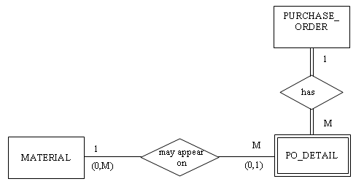
Case Study in E-R Diagramming: Example
Business Rule #2: When a raw material or supply is ordered, it is done using a purchase order, where it appears on the purchase order detail. Purchase orders are also used to order capital equipment and services.

Slide 27
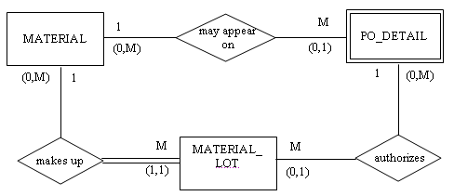
Case Study in E-R Diagramming: Example
Business Rule #3: For each Material there may be zero, one or many Material Lots. Each Material Lot is the manifestation of one and only one Material.

Slide 28
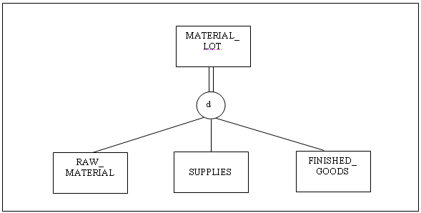
Case Study in E-R Diagramming: Example
Business Rule #4: The entity Material Lot includes inventoried raw materials, supplies, and finished goods. These categories are non-overlapping and each instance of a Material Lot must appear in one and only one category.

Slide 29
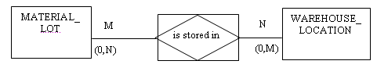
Case Study in E-R Diagramming: Example
Business Rule #5: A Material Lot is stored in one or more Warehouse Locations. A Warehouse Location may store zero, one or more Material Lots. When a Material Lot is removed from warehouse storage and taken to the production area, it still exists as a Material Lot but it is not in warehouse storage.

Slide 30
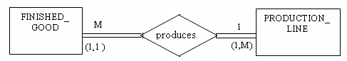
Case Study in E-R Diagramming: Example
Business Rule #6: If a Material Lot is finished goods, it was produced on a Production Line. A Production Line can produce more than one Material Lot, and each lot of finished goods will be produced on one and only one Production Line.

Slide 31
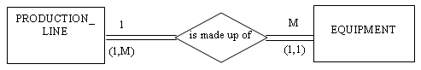
Case Study in E-R Diagramming: Example
Business Rule #7: A Production Line is made up of one or more pieces of Equipment. Each piece of Equipment is part of one and only one Production Line.

Slide 32
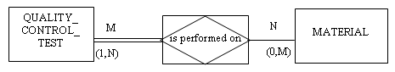
Case Study in E-R Diagramming: Example
Business Rule #8: Materials may have quality control tests associated with them. Some Materials are not subject to quality control tests. Some Quality Control Tests are performed on more than one Material and some materials require more than one quality control test.

Slide 33
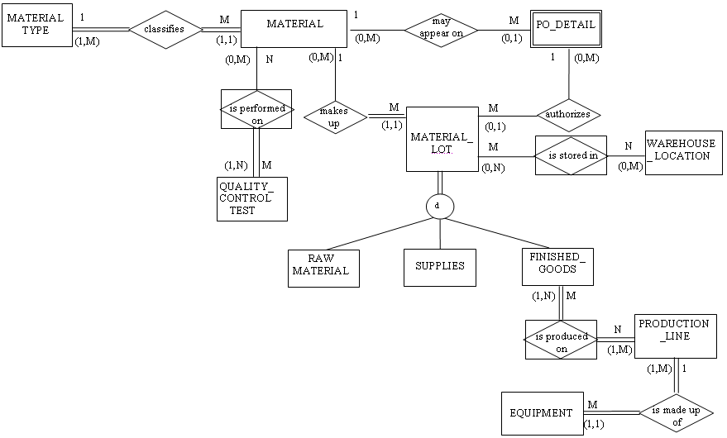
Case Study in E-R Diagramming: Summary

